Slide 1
THE
TREBLE MAKERS!
TREBLE MAKERS PLAYLIST
Search
Home
Library
Jui Nagarkar, Adawn Symonette, Injuu Jyenis, & Jack Deveney
Notes:
Adawn

Slide 2
01
Introduction
Our Music Playlists
Search
Home
Library
Notes:
Adawn

Slide 3
Introduction
In our capstone project, we worked to build a recommender system using the music dataset. Recommender systems play a vital role in helping users navigate through vast options, enhancing user engagement and satisfaction in various digital platforms. This presentation will explore how we can utilize data from over 92,834 user-artist listening interactions, coupled with tagging and social networking information from 1,892 users, to craft personalized music recommendations.
Notes:
Adawn

Slide 4
02
Data Exploration
Our Music Playlists
Search
Home
Library
Notes:
Adawn

Slide 5
Tools Used
Python
(PyCharm & Google Colab)
SQL
(DBeaver)
Notes:
Adawn

Slide 6
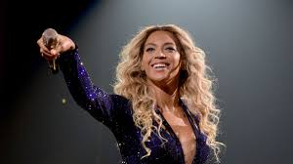
Data Overview
Artists
ArtistID, Name, URL, PictureURL
Tags
TagID, TagValue
User_friends
UserID, friendID
UserArtist
UserID, ArtistID, Weight
UserTaggedArtist
UserID, ArtistID, TagID, Day, Month, Year
Notes:
Adawn
1892 users 17632 artists
Tables
* artists - This file contains information about music artists listened and tagged by the users.
* tags – TagValue (Hashtags...eg. "80's", "indie", "thrash metal"
* userArtists – user listening count
* userTaggedartists-timestamps
* user_friends These files contain the friend relations between users in the database.

Slide 7
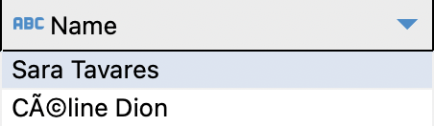
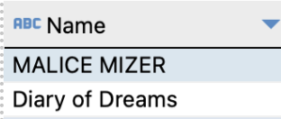
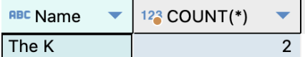
We started off by cleaning the data to complete a thorough exploration of the data. This is necessary To ensure consistency and facilitate accurate data comparison. The purpose was to:
Correct Data Errors and Inconsistencies
3:15
Standardize Formats
3:20
Check and Remove Duplicates
3:10
Notes:
Adawn
We started by cleaning the data using SQL
We checked for data errors and inconsistencies. Some artist names contained special characters that were not correctly displayed due to encoding issues.
We handle the encoding of the special characters in python, we did experience some challenges that we will touch on as we continue on with the presentation
We standardize the data, we opted for capitalizing the text fields
We check and remove duplicates.

Slide 8
03
Collaborative-Based
Our Music Playlists
Search
Home
Library
Notes:
Jack

Slide 9
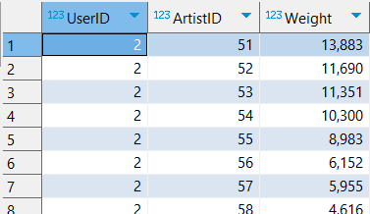

Our Music Playlists
Search
UserArtistTable
Home
UserID is a number that represents the user
ArtistID represents a specific artist
Weight is how much the user listened to a specific artist
This is the main table that is used for collaborative based filter
Library
Notes:
Jack

Slide 10
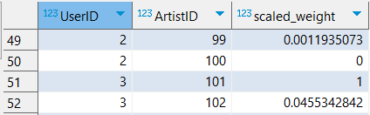
Our Music Playlists
Search
To begin the collaborative filtering we used the min-max scaling for each user so each user will have a max scaling weight of 1.
Home
Library
Notes:
Jack

Slide 11
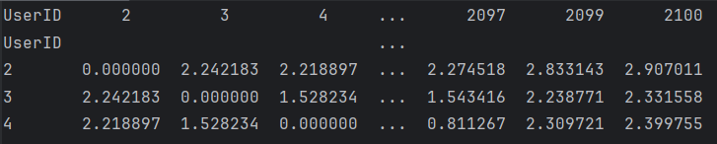
Our Music Playlists
Search
We made a similarity matrix by finding the Euclidean distance between all of the different user's scaled listening weights.
Home
Library
Notes:
Jack

Slide 12
Our Music Playlists
Search
We then use that similarity matrix to find the most similar user by find the user that has the minimum value within our chosen user's column.
We can then use the user that is most similar to find the artist we are recommending by finding their most listened to artists.
Home
Library
Notes:
Jack

Slide 13
04
Content-Based
Our Music Playlists
Search
Home
Library
Notes:
Injuu

Slide 14

Our Music Playlists
Search
TagsTable
ArtistsCategoriesTable
Home
TagID is a number that represents the tag
TagValue is posts users made
Category represents the refined music genres
Created Table that has Artist ID, Artist Name, Tag Value & Category for the convenience
Library
Notes:
Injuu

Slide 15
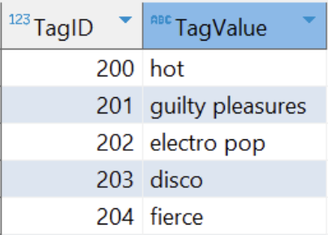
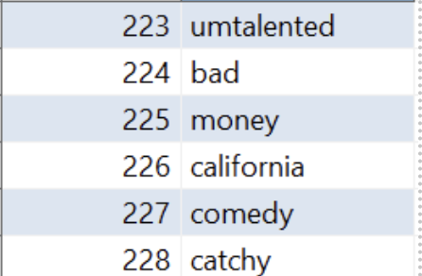
For the content-based filtering, we did some data cleaning to emphasize music-related hashtags. This involved eliminating irrelevant hashtags and grouping similar ones.
The images are examples of the hashtags in the tag value column that we wanted to clean to give more relevance and refinement to our search.
Notes:
Injuu

Slide 16
The list was refined using machine learning techniques. We created a terms versus frequency graph for bigrams and unigrams to find the top 10 values that match in both the graphs and further modify the database.
Followed Pre-Processing Steps:
- make everything lowercase
- remove numbers
- remove punctuation
- remove extra spaces
- remove stopwords
Notes:
Injuu

Slide 17
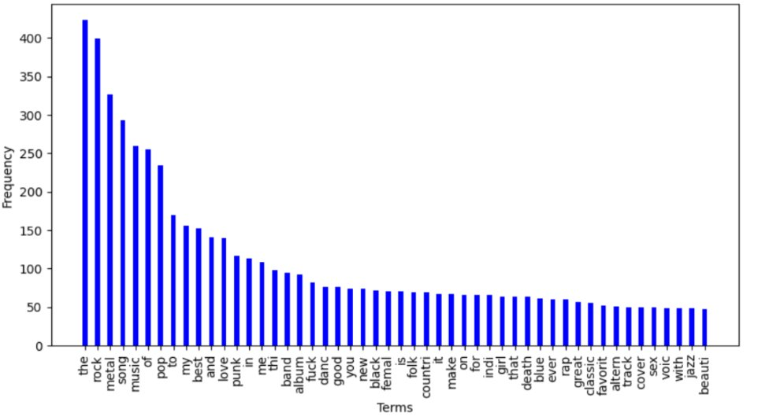
UNIGRAMS
Notes:
Injuu

Slide 18
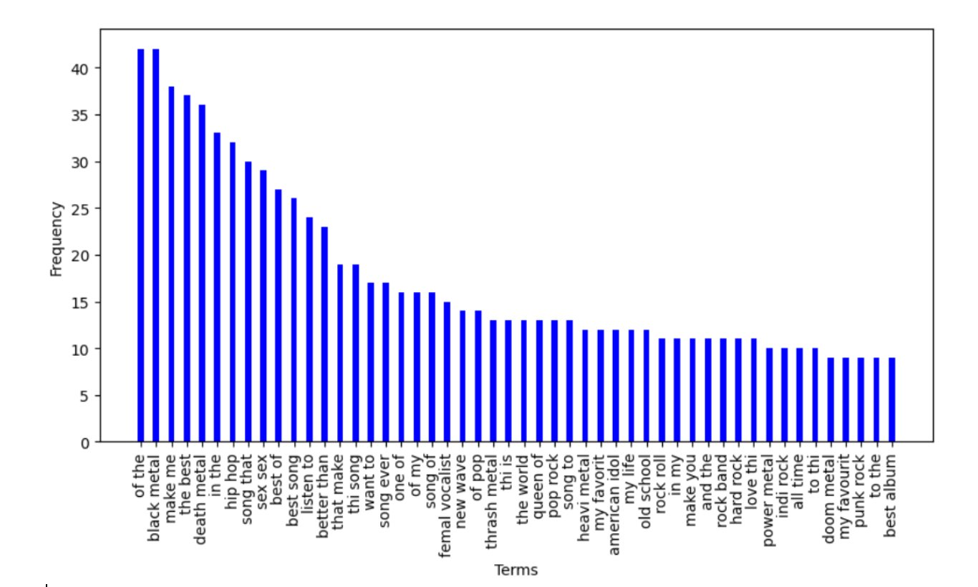
BIGRAMS
Notes:
Injuu

Slide 19

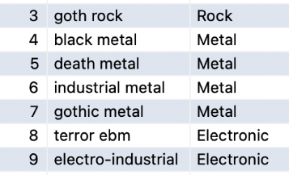
To help improve the accuracy and relevance of our music recommendations system we grouped the hashtags into categories. A new column was created, and we identified key terms that are indicative of the specific genre.
Other examples of these categories were 'Hip Hop and R&B', 'Pop', 'Classical', 'Decades' and 'Foreign Music' to name a few.
Notes:
Injuu

Slide 20
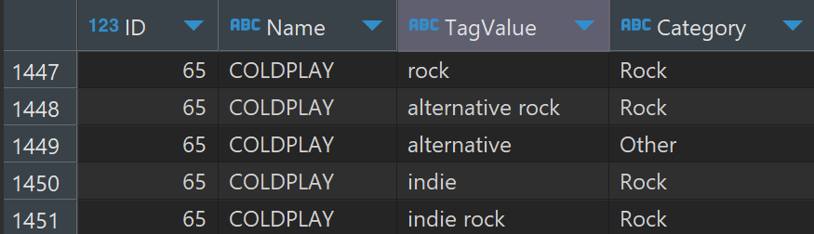
Then, we created a table called 'ArtistsCategories' where we have Artist ID, Artist's Name, Tag Value related to them and which Category they belong to. The following is an example of Coldplay:
Notes:
Injuu

Slide 21
We tried filtering by Category, User ID and Artist Name --> Unfortunately, we got thousands of results for the recommendations
One hot encoding
Similarity Matrix
Recommending additional artists for specific users who listened to an artist "X"
Notes:
Injuu

Slide 22
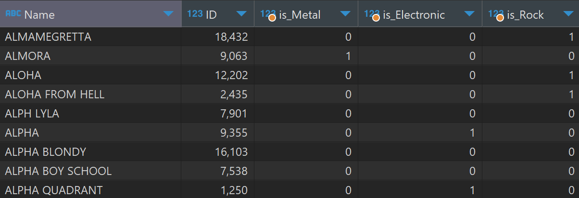
Part of our huge one hot encoding table:
Notes:
Jui

Slide 23
Created a table specifically for the artist "RIHANNA":
Notes:
Jui

Slide 24
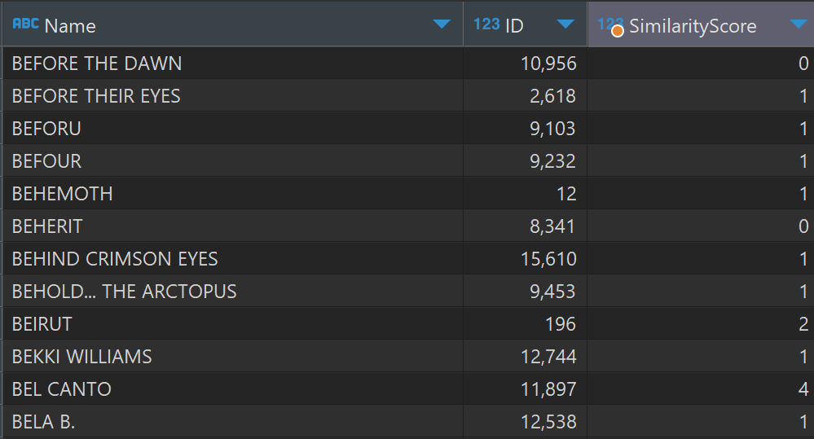
Part of our similarity score table:
Notes:
Jui

Slide 25
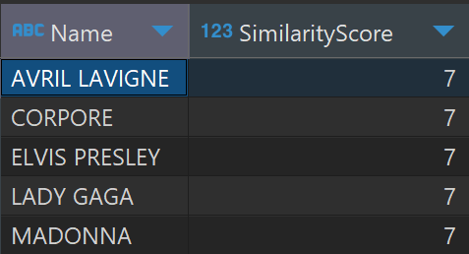
Our Music Playlists
Search
We then chose a specific User ID to generate recommendations for Rihanna:
Home
Library
Notes:
Jui

Slide 26
05
Hybrid Filtering
Our Music Playlists
Search
Home
Library
Notes:
Jui

Slide 27




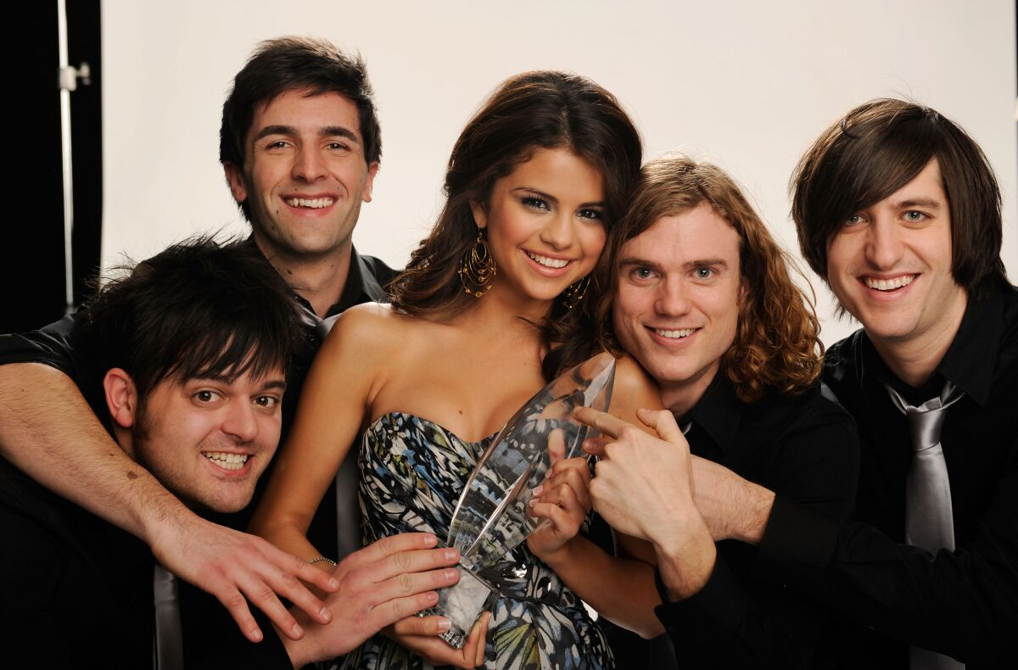
Checked recommendation for a specific user:
Based on what similar users have listened to:
Jonas Brothers
Justin Bieber
Bruno Mars
Chris Brown
Selena Gomez and the Scene
COLLABORATIVE
Notes:
Jui

Slide 28
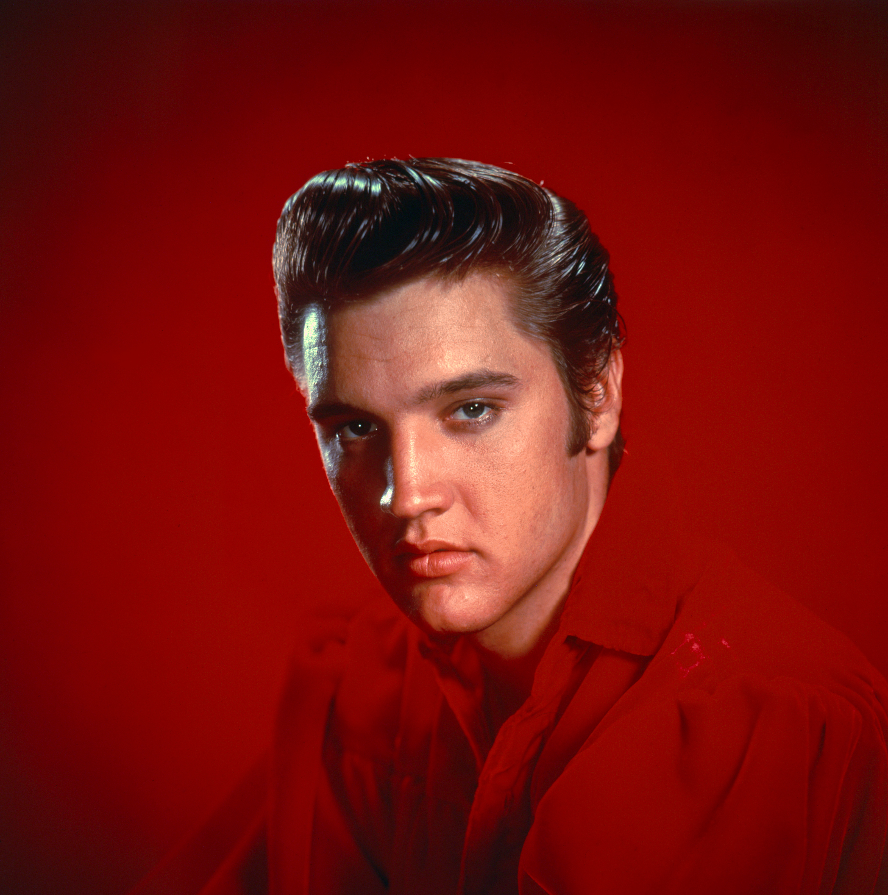
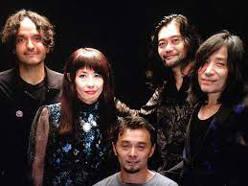

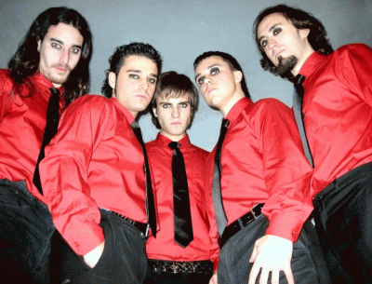
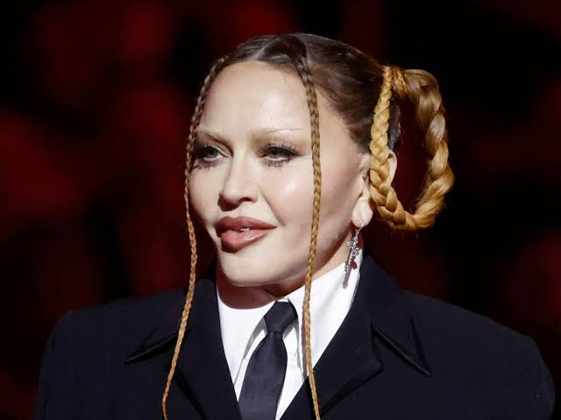
Checked recommendation for a specific user:
Since you listened to this artist, here are 5 others we think you would like!
Avril Lavigne
Elvis Presley
MONO
Corpore
Madonna
CONTENT
Notes:
Jui

Slide 29
Conclusion
Our GOAL as The Treble Makers is to make the BEST hybrid music recommendation system
Clean and preprocess the data to make sure we can use it
Collaborative Based Filtering
- Min-Max scaled the listening weights for each user
- Created similarity matrix
- Found recommendations from similarity matrix
Content-Based Filtering
- Created categories for each tag
- Hot-encoded each artist to each category
- Used dot product to find most similar artist to give recommendations
Used both filtering methods to create hybrid recommendations
Notes:
Jui

Slide 30
Our Music Playlists
Search
"Thank you for listening!"
Home
Library
Do you have any questions?
—The Treble Makers
Notes:
Jui

